Slide 1
Chapter 17 Temperature & Heat

Slide 2
Heat is an amount of energy in a substance in the form of molecular motion, or kinetic energy. It is ‘global’, or contained in a whole mass. Heat is measured in Joules or calories. 1 calorie = 4.187 Joules (Physics calorie) 1 Calorie = 1 kilocalorie = 1,000 calories. (Food Calorie) 1 Btu (British thermal unit) = 252 calories = 1055 Joules Temperature is a measure of the average kinetic energy in a location. It is ‘local’.

Slide 3
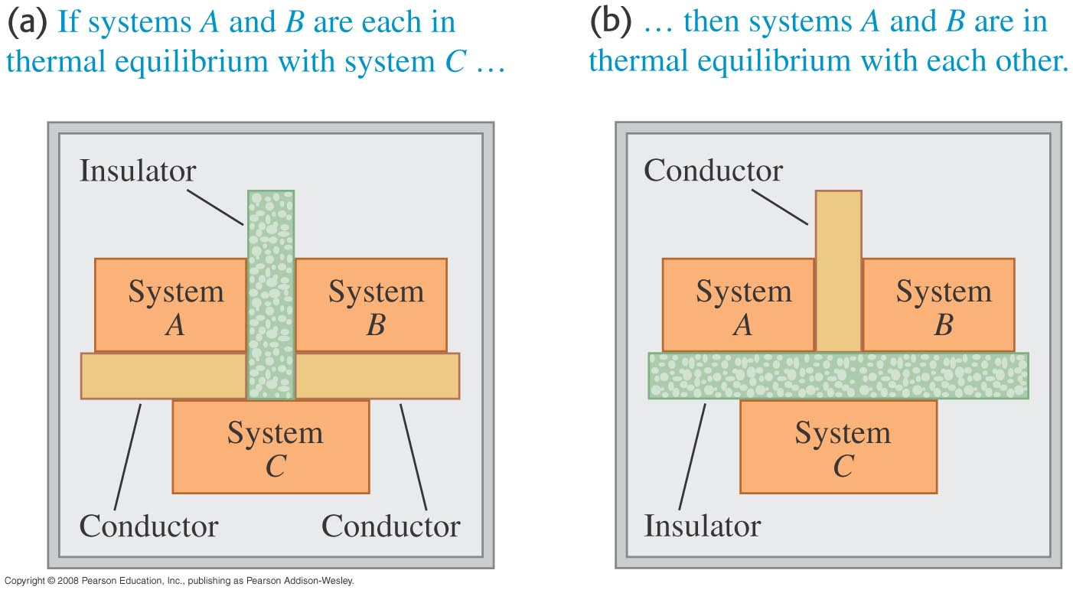
The zeroth law of thermodynamics
Simply stated? “Heat will always travel from a hot reservoir to a cold one without outside energy forcing an unnatural transfer.”

Slide 4
The three temperature scales:
Fahrenheit, Celsius, and Kelvin. T(F) = (9/5)T(C) + 32, and the reverse conversion can be found from it by algebra. T (Kelvin) = T(Celsius) + 273.15.
Absolute zero is zero Kelvin (no motion of the molecules except for a quantum amount). This is equivalent to -273.16º C.

Slide 5
Heat depends on mass, temperature and specific heat.
dQ = mcdT = nCdT, c = specific heat, C = specific heat/mole. Thus
c = (1/m) dQ/dT. c (water) = 1 calorie/g degree C (approximate).
Specific heat, c, for a substance is the amount of heat necessary to raise one gram one degree C.

Slide 6
Expansion:
Heat expands, cold contracts. Some substances expand more when heated.
Differing coefficient of linear expansion, α .
1 Dimension: Thermal expansion of wire: ∆L = αL₀∆T.
3 Dimensions: Thermal expansion of volume: ∆V = βV₀∆T. β = volume expansion coefficient
Tensile (or Thermal) Stress:
(for bound rod) F/A = -Yα∆T.

Slide 7
HEAT TRANSFER (3 Ways):
Conduction: transfer of Kinetic energy by collision of molecules, atoms, or other particles.
Heat current, H = dQ/dt = kA∆T/L. (k = conductivity, A=area)
Metals are the best conductors of heat and electricity, since they have ‘loose’ electrons.
Insulators: poor conductors--outer electrons in the atoms are firmly attached. Liquids and gases are usually poor conductors.
Heat is transmitted from high temperature to low.
2. Convection: heat is conveyed by currents in liquids or gases. Often this happens because a heated parcel of fluid rises and cools then sinks.
3. Radiation: transfer of energy in the form of light. Heat radiation or infrared is a form of light. Light can be radiated even in empty space.

Slide 8
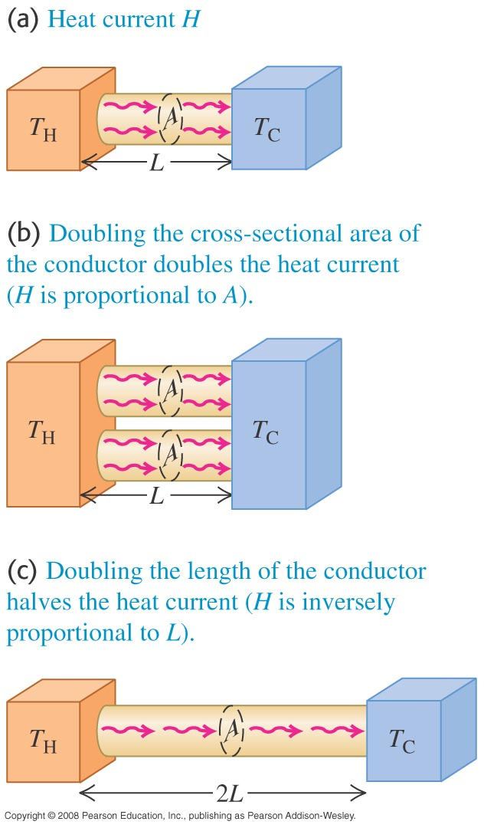
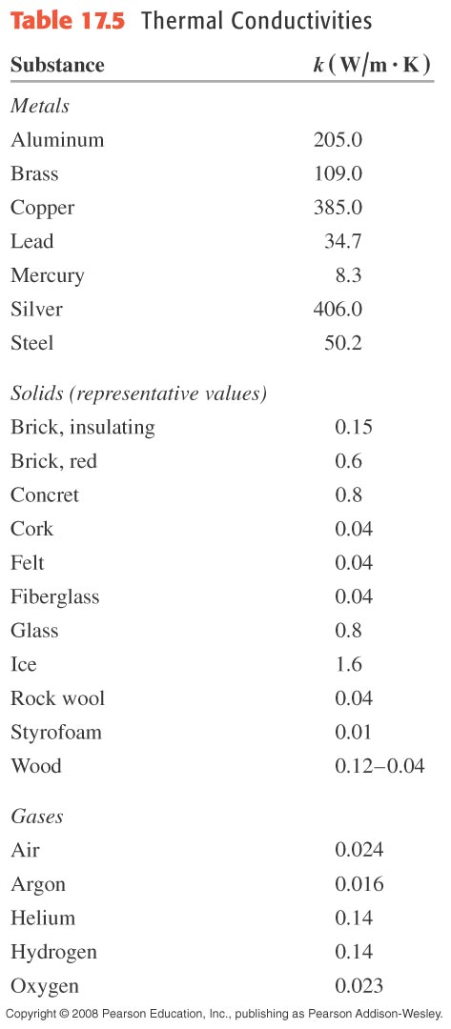
Why, and how well, do materials transfer heat?
Figure 17.23 illustrates the model.
Table 17.5 lists thermal conductivities. They are dramatically different, from very large values for conductors like metals to very small values for insulators like styrofoam or wood.
.
dQ/dt =kA(∆T)/L,
k = thermal conductivity

Slide 9
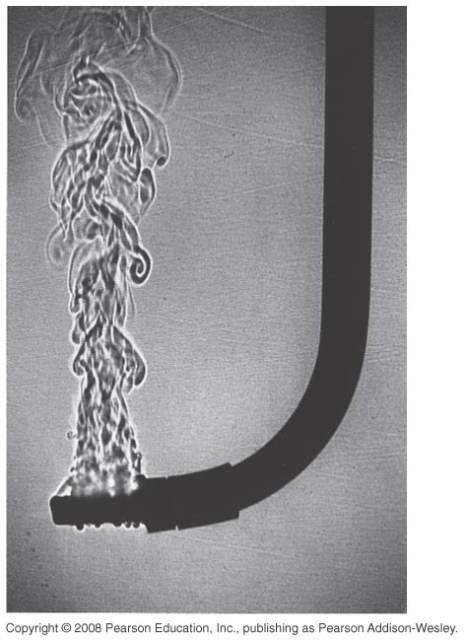
Convection of heat
Heating by moving large amounts of hot fluid, usually water or air.
Figure 17.28 at right illustrates heat moving by convection.
dQ/dt prop to. ∆T^5/4

Slide 10
Radiation
Stephan-Boltzmann relation: H = AeσT⁴ σ = 5.67 x 10⁻⁸ W/m²K⁴
The process of radiation involves emission or absorption.
Emission is when light is given off by a substance.
Absorption is the taking on of energy by an electron, atom, or molecule.
A black body is a perfect emitter and absorber.
The Greenhouse Effect: ultraviolet radiation hits the earth and is converted into infrared light (heat). Carbon dioxide, water molecules, and methane act like a blanket and hold the heat in the atmosphere (Global Warming?).
Solar Power: Energy radiated from the sun--about 1387 watts of power hit every square meter of the earth (adjusted by the angle the surface and the absorption of the cloud cover).

Slide 11
CHANGE OF STATE Q = mL
Melting point: the temperature at which a solid is converted to a liquid.
Latent Heat of fusion: the heat necessary to melt a solid. This is Lf = 80 cal/g for ice.
Boiling point is the temperature at which a liquid boils to a gas.
Latent Heat of vaporization: the heat necessary to vaporize a liquid. This is Lv = 540 calories/g for water.

Slide 12
OTHER PHASES (& details):
Brownian motion is the random buffeting of suspended particles by air molecules. (Example—dust in the air)
Boiling point also depends on pressure. Water boils at a lower temperature in the mountains, where the air pressure is lower. The vapor has a higher relative pressure and escapes.
Many other phase transitions occurring at a transition temperature: magnetic at the Curie Temperature. Others: crystal, liquid crystal, quasi-crystal, superconductivity, etc…

Slide 13
Chapter 18 Thermal States of Matter

Slide 14
Equation of State of Solid (reasonable range)
Experiments →
V = V₀[1 + β(T-T₀) – k(p -p₀)]
Compressibility, k = -(1/ V₀)∆V/∆p
(T = const.)

Slide 15
Molecular awareness:
For n constant, PV/T = constant, a useful form.
Pressure caused by molecular impacts
1 atm → v(avg) = 1000 mi/hr.
Think atomic!

Slide 16
Ideal Gas Law:
for no intermolecular interaction, pV = nRT, n =m_{tot} /M, M is mass/mole, R = 8.31 J/mol K.
This is an example of an Equation of State and State Variables (in this case p, V, and T).
I mole of molecules contains N_{A} = 6.022 x 10²³ molecules. M = N_{A} m (m = 1 molecule mass)

Slide 17
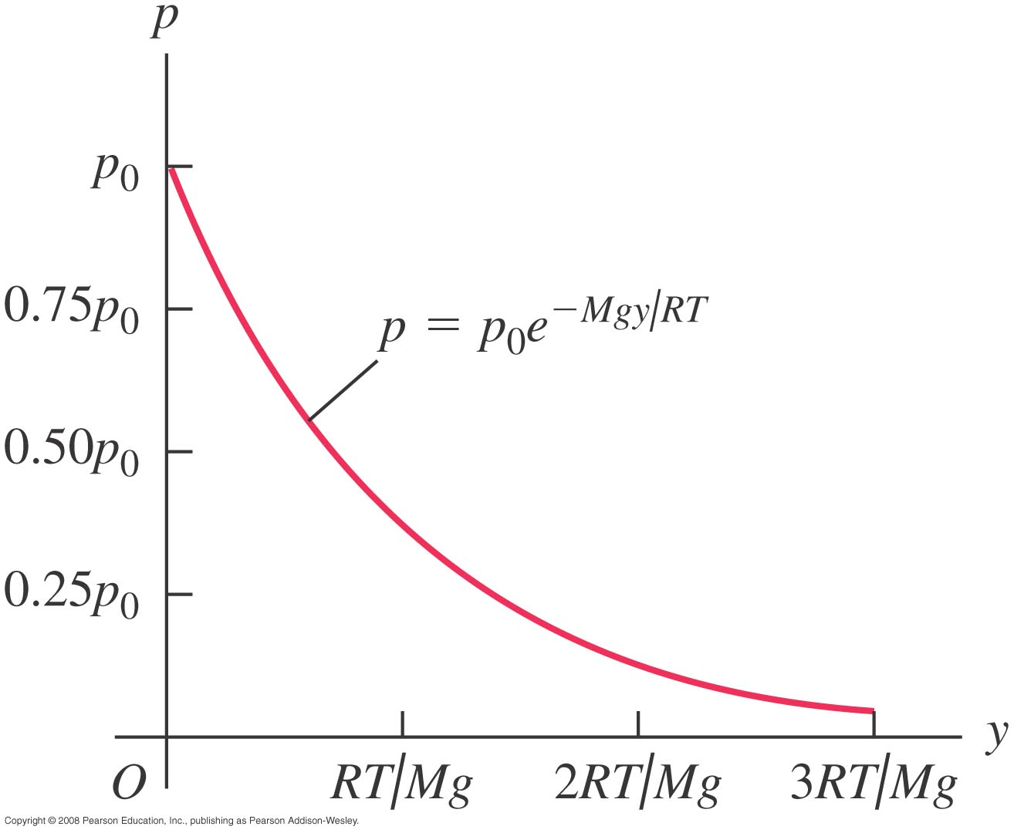
Variation of pressure as elevation changes
Compression by weight of gas above makes exponential falloff.
Will prove P(Everest) = .33 atm.

Slide 18
Van der Waals Equation
(P + an²/V²)(V-nb) = nRT More detail than Ideal Gas law.
a represents intermolecular forces
b scales down volume occupied by molecules
Ex. CO₂ requires .5% correction at STP
= 0 °C, 101.325 kPa [1 atm or 760 Torr (mm Hg)].
(some standards use 15 or 20 °C)

Slide 19
Other Important characteristics of gases:
Mean Free Path, λ = V/(4π√2r²N), where N/V is # of molecules/volume.
Molar Heat Capacity of ideal monatomic gas C_{V} = (3/2)R, diatomic: C_{V} = (5/2)R ,
Solid: C_{V} = 3R.
Maxwell-Boltzmann velocity distribution of an ideal gas:
f(v) = 4π(m/2πkT)^{3/2} v²e^{-mv2/2kT}. Tough derivation, not in text.

Slide 20
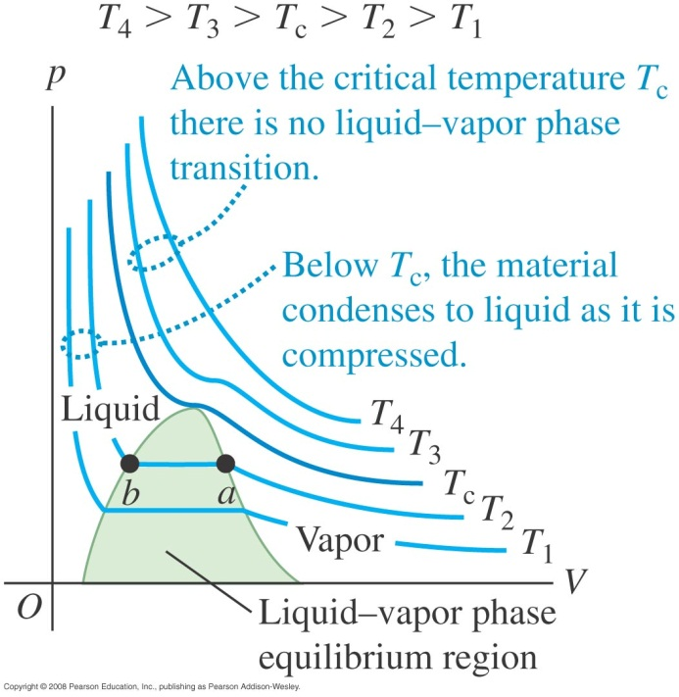
Δ(PV) curves at constant temperature—isotherms
A single experiment can measure how pressure changes as volume changes. This is an isothermal curve.
Many isothermal curves together make a three-dimensional phase surface.

Slide 21
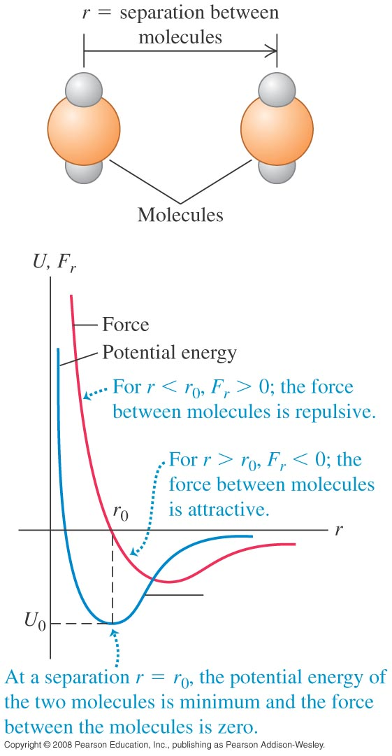
Molecular properties of matter
Just for perspective, the amount of carbon in the graphite of just one #2 pencil represents 10²³ carbon atoms.
Each adjacent atom (or molecule) in a sample will experience forces from its “neighbors.” These forces range in strength over several orders of magnitude.
F = - dU/dr (spherical symmetry. Molecules fall to the bottom of well

Slide 22
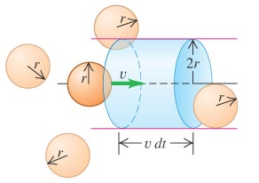
How often do atoms/molecules in ideal gas collide?
Work on board (from notes) implies
# collisions = (1/2)(N/V) Av_{x}dt
This allows us to calculate
Momentum on wall, dp,
Then F = dp/dt
and pressure, P = F/A
P = Nm v_{x}²/V.
More work on board Plus KE= (3/2)nRT from expt.→
PV = nRT and PV = NkT,
k = Boltzman’s Constant

Slide 23
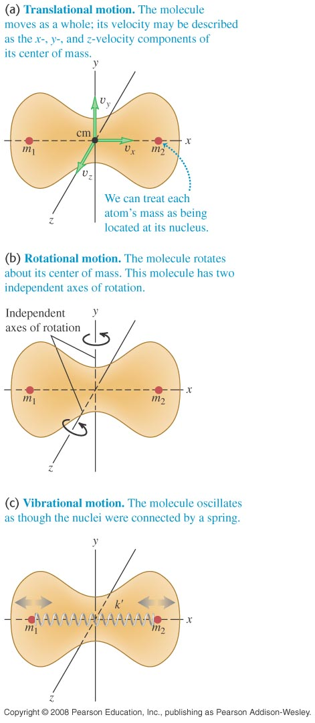
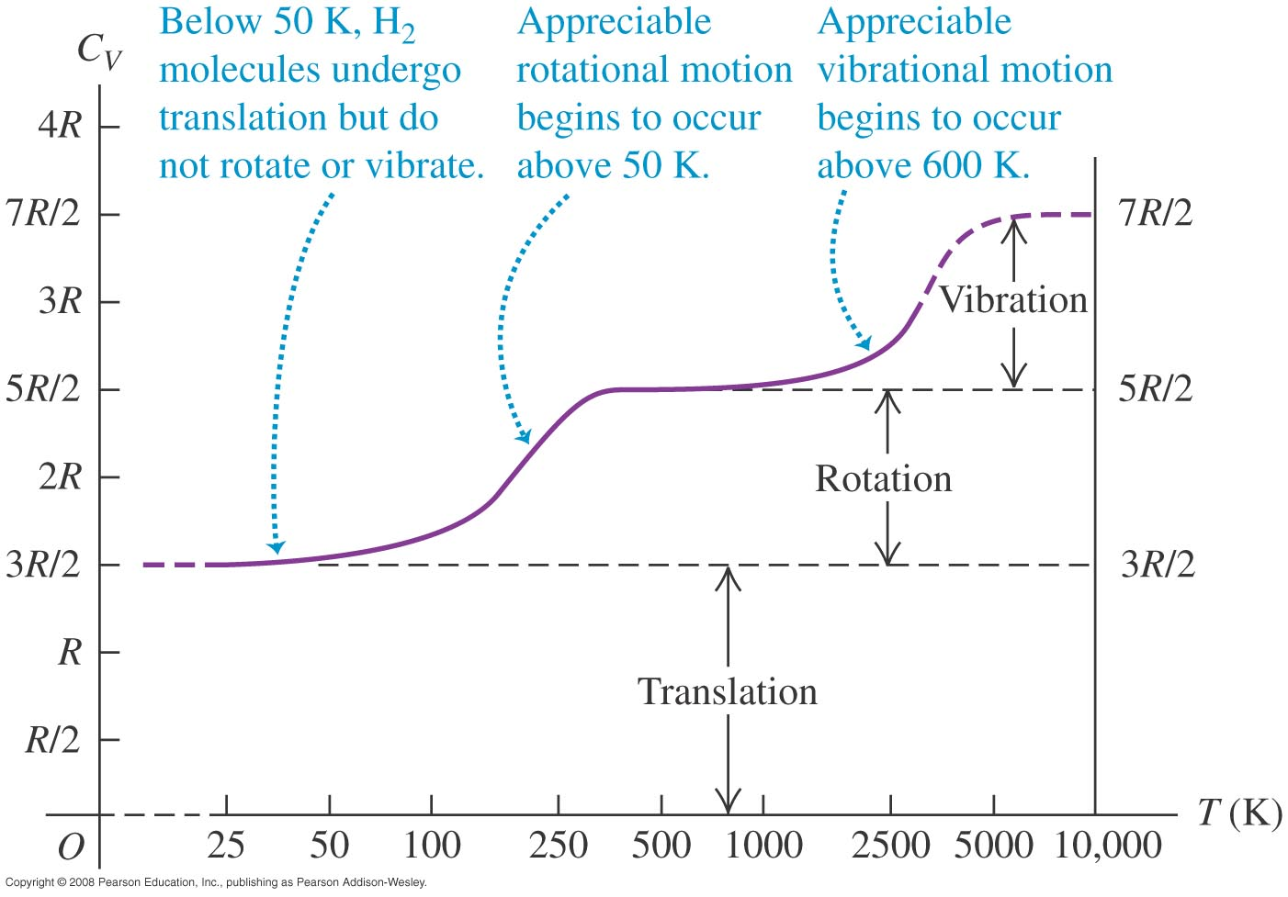
Illustration of heat absorption into degrees of freedom

Slide 24
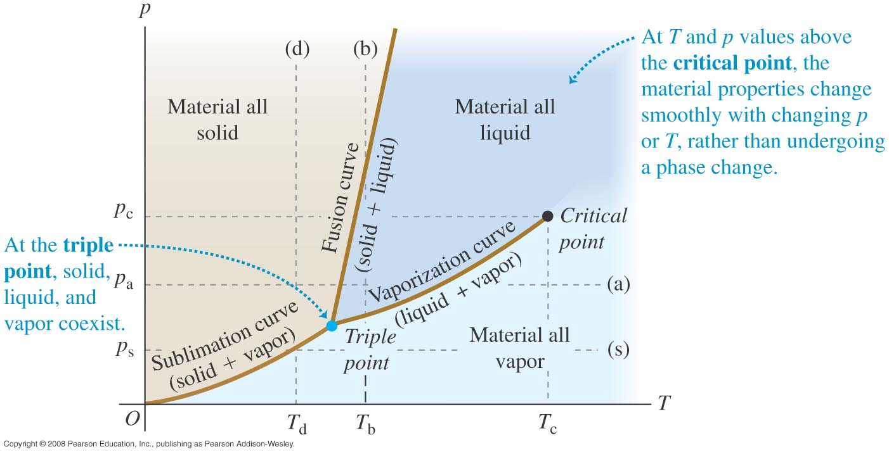
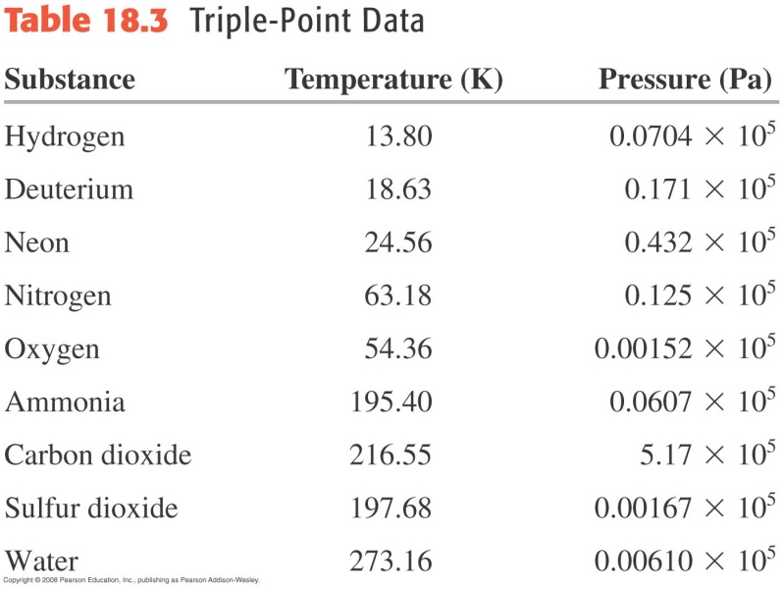
The positions of (s), (l), and (g) are plotted on phase diagrams
Lines are drawn for freezing, melting, and boiling curves on a pT axis.

Slide 25
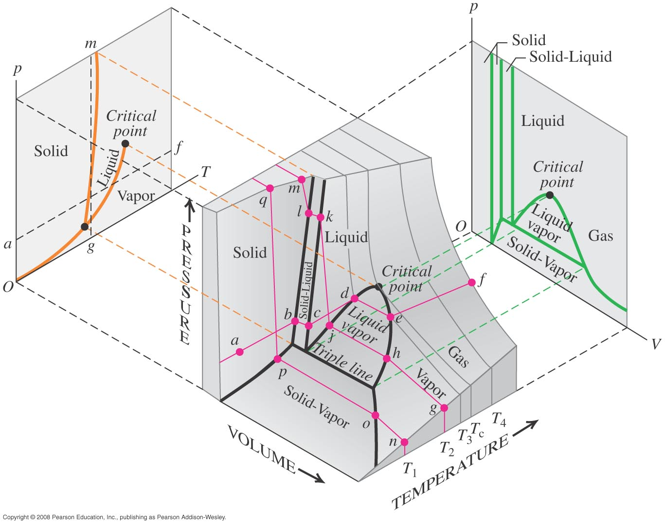
P, V, and T may all be plotted to form 3-D surfaces

